Slide 1

Five things you should do before taking the QPIP Exam – Tips and tricks based on experience from 2021
Michaela Rasmussen

Slide 2
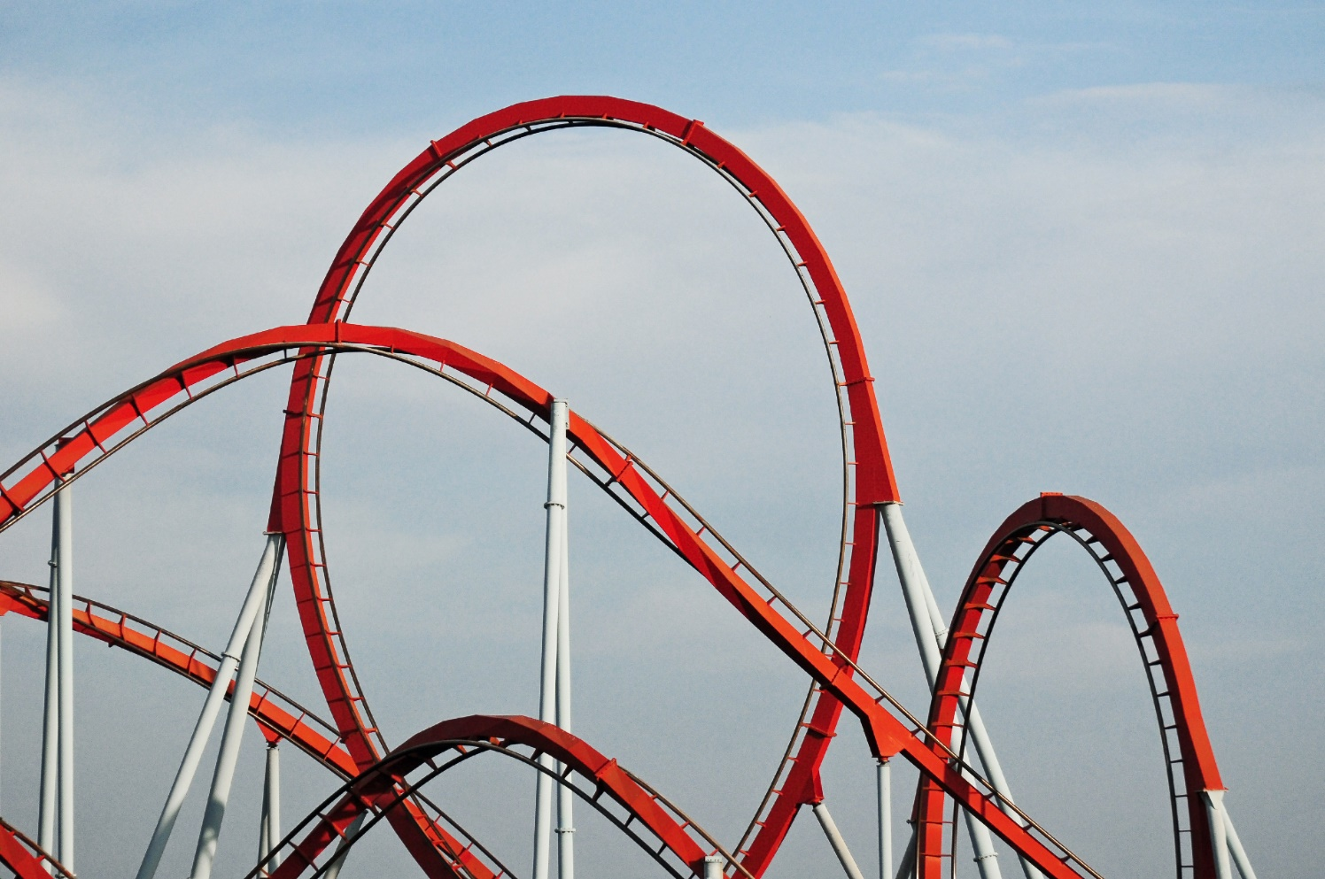
How was it taking the exam?
Notes:
It was a rollercoaster: Stressful, intense, focused, tired, confident and then not confident. Like any other exam.

Slide 3
Preparations
Feb 2021
Syllabus/reading up, collection of useful links,
demo of online exam platform
2011
Mock exam
2005
DKPTO
Searcher and Examiner
2018
Prior Experience Recognition
- Yes or no?
Feb 2021 Exam day
Tea, snacks provided by Manager
Notes:
First exam (no previous exam sets to study), so I would say that my preparations, or at least my experience, started already many years ago.
DKPTO: Provided training in searching and evaluating documents in relation to claims. The experience in evaluating novelty and inventive step came in handy during the exam.
In Coloplast: Searcher in inhouse department, so no work in evaluating documents in depth (the inhouse Attorneys do this part).
The mock exam did give some idea of what the exam would be like. After mock exams I expected the certification to approach quickly. Quite some years went by and I started to doubt about if the certification would ever become real.
After the PER I expected the exams to approach.
Syllabus was available – I highlighted the subjects where I found myself to be most inexperienced. In my case that was the things where we as Searchers in Coloplast go and ask our inhouse Attorneys (specific rules and regulations, uncertainty about dates etc.). Also made a collection of useful links (rules and regulations) on the web so that I could look things up if I was in doubt during exams.

Slide 4




Exam day 1
At the end of the day
  Confident
  Relieved
  Tired and hungry
Notes:
Exited, nervous
Online platform – would it work?
Identification, upload of photo ID - would It work? How many minutes would that take?
Would the wi-fi crash? And other practical issues…
What to expect?
Would I have enough time?
Would the questions be clear and specific?
Would the technical topics be understandable?
Online platform worked well. So did wifi and ID; however, a bit stressed due to timing of moving from one module to the next – timing of when to ID-yourself before getting ready for next module.
The technical subjects were easily understandable, so that was a relief.

Slide 5

Exam day 2
Notes:
Started confident and relaxed, …..

Slide 6



Exam day 2
At the end of the day
  In doubt about the results
  Did not feel confident
  Very tired and hungry again
Notes:
…. but quickly turned into stressed state
First module did not go well in my opinion -> Stress!
No time to look things up, if in doubt
Most difficult were the questions where I would normally ask our inhouse Attorney
First module was short answer questions and I did not have a good feeling about how that went!
NOTE from the ISBQPIP: after the first exam in 2021, the order of the exam parts was changed. In 2021 the first day consisted of the two search cases, the second day of both theory parts, the categorisation case study and the patent landscape case study.

Slide 7
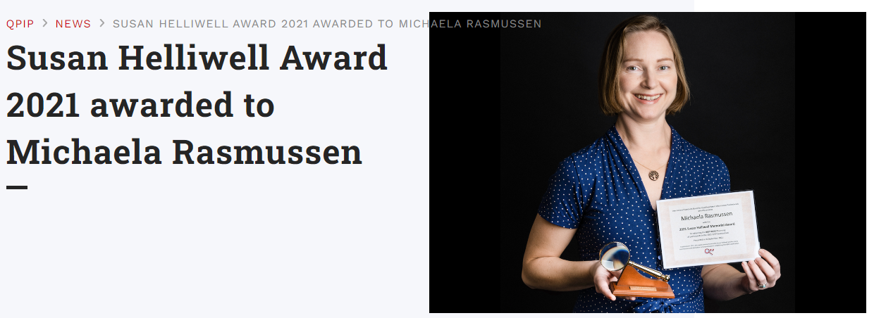
Post exam benefits
Confidence, recognition of my qualifications
CV (if looking for new opportunities in the future)
Honor the huge effort from the QPIP team by taking the exam
Inspire others
Proud that I challenged myself
Notes:
At the end everything went allright and I passed.

Slide 8
Five things you should do before exam
Focus on your weakness: Study the search skill syllabus and highlight what you need to refresh or train
Recognize the patterns: Go through the previous exam sets, so you know what to expect
Lawyer up: If you have an inhouse Patent Agent, ask if he/she could set off time to answer any questions you have on “Agent related stuff”
Know by heart: Do not think you have time to look things up
Optimize your time and effort: Know you search tool(s)
Notes:
”attorney related stuff”= could be questions about dates, priorities, inventive step, omnibus claims, rules etc.
Search tool: Know how to upload numbers, family definitions, how to create graphs, which graphs are available etc.

Slide 9
Just Do It !!!
Just Do It - Wikipedia

Slide 10

THANK YOU to everyone from QPIP team
Questions: Find me in a coffee break or dkmras@coloplast.com
Notes:
Take this opportunity to thank all of those from our community who have put in a lot of effort and time in making the certification possible. It has been a long road but I believe it provides great value for the patent information profession. Thank you for listening.

